Slide 1
Face Recognition
NHÓM 1

Slide 2

What is it?

Slide 3

Target audience

Slide 4

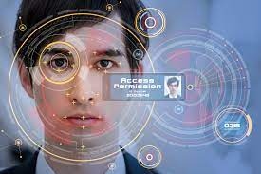
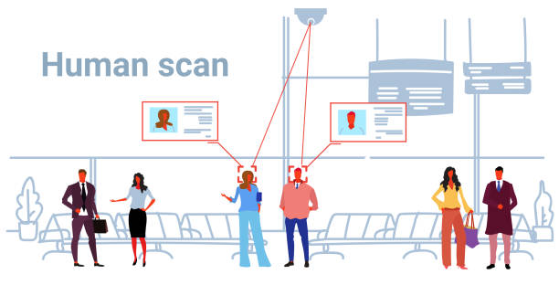
System benefits

Slide 5


Software

Slide 6
Hardware
Name | Cost
ESP32-CAM with OV2640 | $6.99
FTDI programmer | $4.25
Jumper wire | $4.63
Total | $15.87

Slide 7
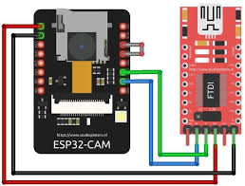
Operating system

Slide 8



Risk of using Face Recognition

Slide 9
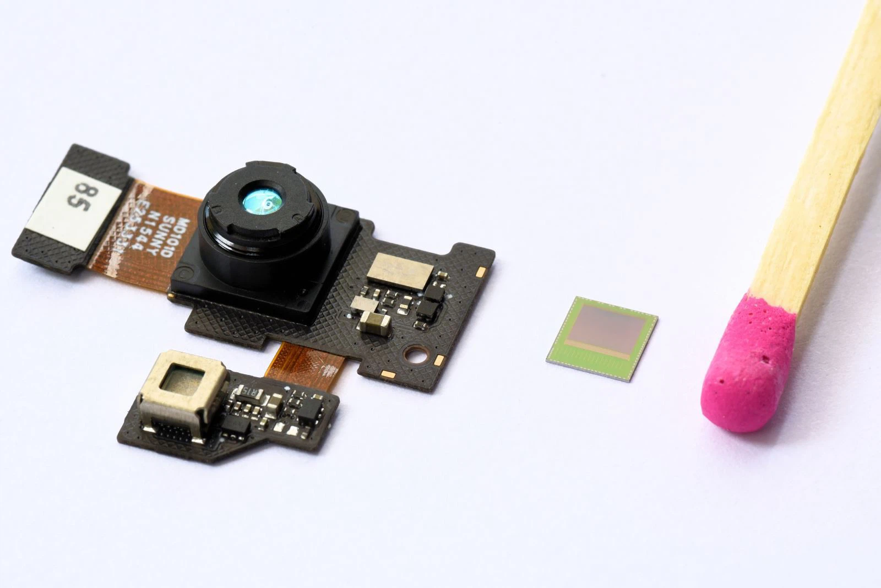
Sensor

Slide 10

THE END

